Slide 1
NFHS Network Game Plan
NFHS Network + Pixellot Cameras Training

Slide 2
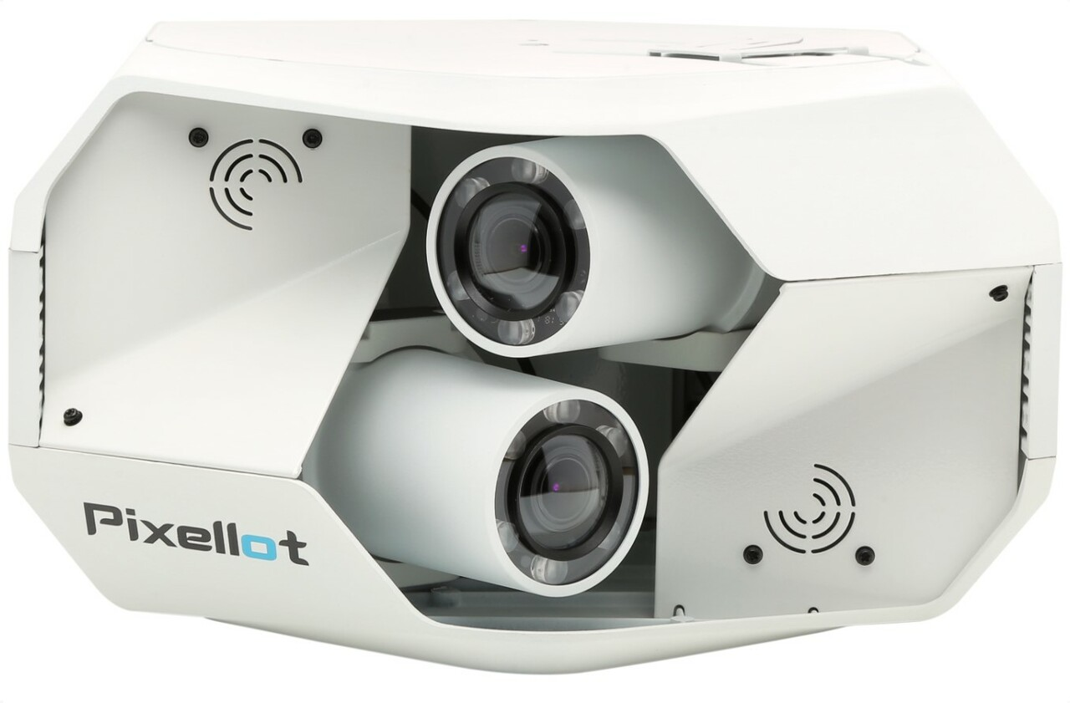
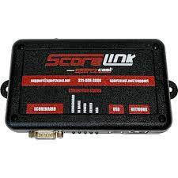
Equipment Overview
Pixellot Camera
Computer Tower
Scoring Devices

Slide 3
Websites to Bookmark
Console (https://console.nfhsnetwork.com)
Back-end system for scheduling/editing games, editing your school page, getting game film, etc.
Console Mobile (https://help.nfhsnetwork.com)
Checking the status of your Pixellot units, stopping a broadcast early, running a test event, submitting help tickets, etc. on your smartphone's internet browser.
Tutorial Website (https://playonsports.zendesk.com/hc/en-us)
Collection of articles and videos about Console, Console Mobile, and FAQs.
NFHS Network (https://nfhsnetwork.com)
Viewing live or on-demand events.
Notes:
Youtube Console Training video: https://www.youtube.com/watch?v=EWOrfM-_FSs
Any questions? Contact accounts@nfhsnetwork.com

Slide 4
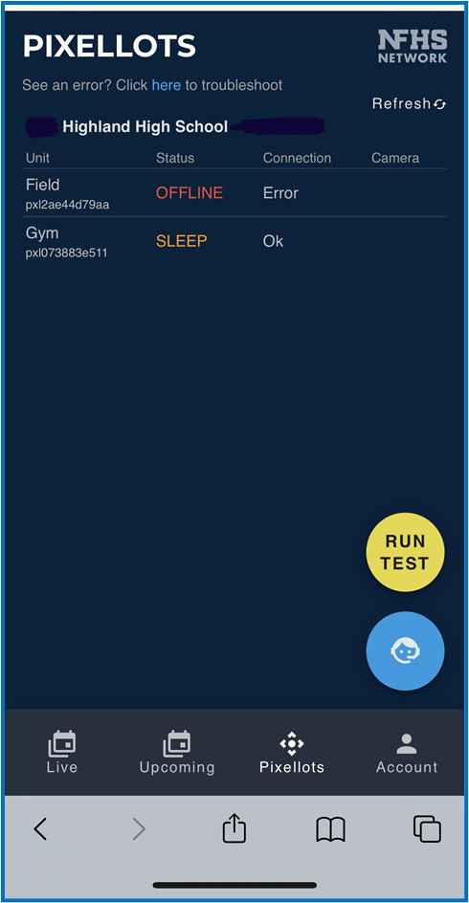
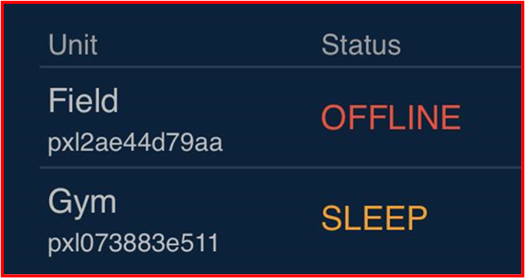
Console Mobile - Checking Pixellot Status
Log into Console Mobile (https://help.nfhsnetwork.com) with your Console credentials.
Click the “Pixellots” tab with the camera icon.
Check the statuses there.
Statuses:
Sleep: Online and ready to stream next event
Live: Event currently streaming
Reset/Offline: Need to check power/internet connection, then submit a ticket to Support

Slide 5
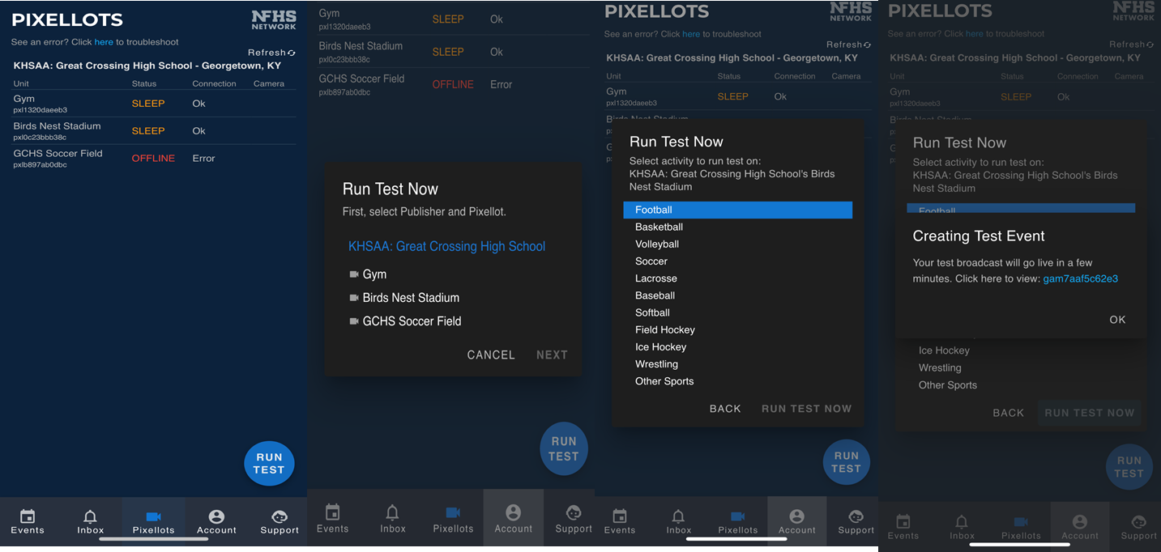
Console Mobile - Running a Test
Test events are a great way to make sure everything is working.
How to run a test event:
Go to http://help.nfhsnetwork.com from your mobile phone.
Click the “RUN TEST” button.
Select your School and Pixellot unit.
Select a sport.
Click “RUN TEST NOW.”
You can click the link to view the test.

Slide 6
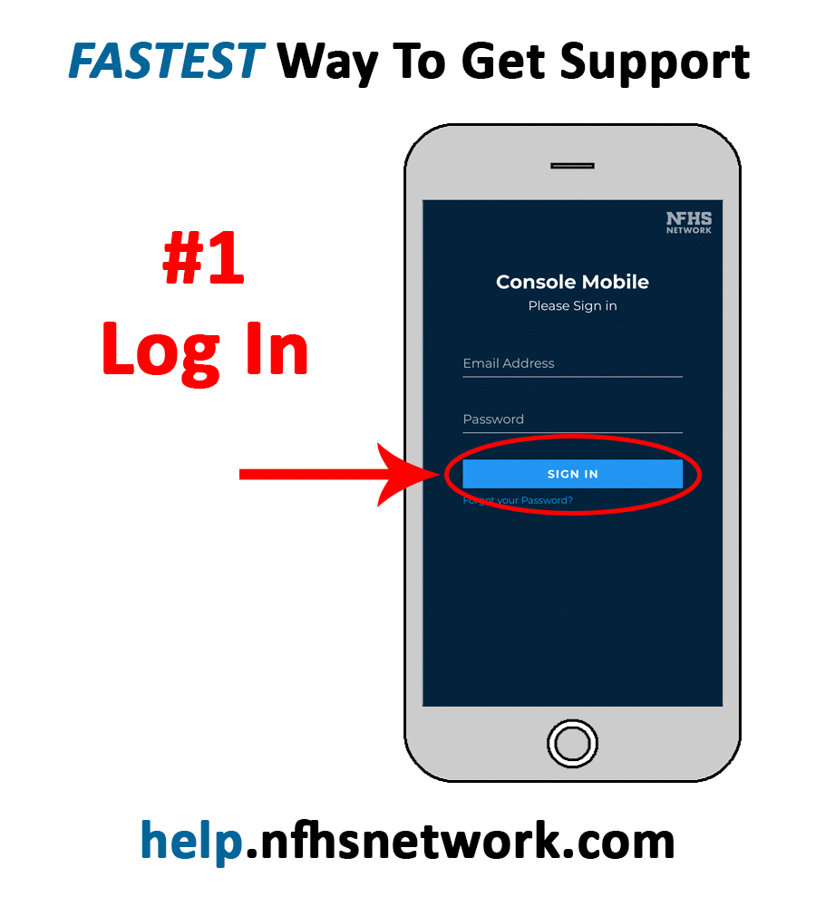
Console Mobile - Submitting a Support Ticket
Log into Console Mobile (https://help.nfhsnetwork.com) with your Console credentials.
Click the yellow “GET HELP” button at the bottom of the screen.
Fill in all fields and select a category under “What is this issue related to?” If prompted, give as much information as possible in the “Briefly Describe the Issue” text box.
Click “Submit Request.”
Keep an eye on your email/phone for the Support Team’s response.

Slide 7
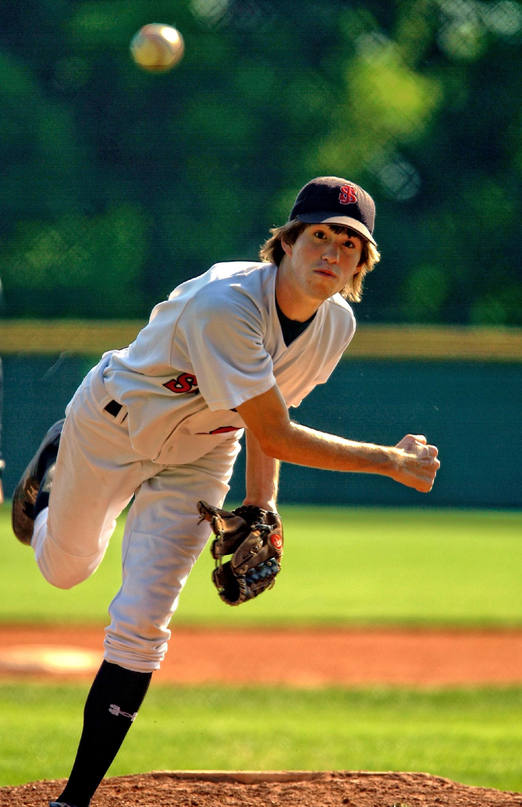
Your NFHS Network Team
Customer Success Manager:
Email: success@playonsports.com
Technical Support:
Email: support@nfhsnetwork.com
Live Game Support:
Submit a ticket through help.nfhsnetwork.com

